Slide 1
SURFACE ANATOMY OF THE LOWER LIMB: Practical Workshop
PT7001/PT4050
Ngozi Onuegbu PhD
Walaa Abu-Taleb

Slide 2
Learning Outcomes
By the end of this lecture, you will be able to:
Accurately identify and palpate major anatomical landmarks of the lower limb
Understand the functional significance of various bony prominences
Describe the surface anatomy and palpation techniques for identifying structures of the lower limb
Differentiate Between Lower Limb Joint Landmarks
Apply the knowledge of anatomical landmarks in a clinical setting

Slide 3
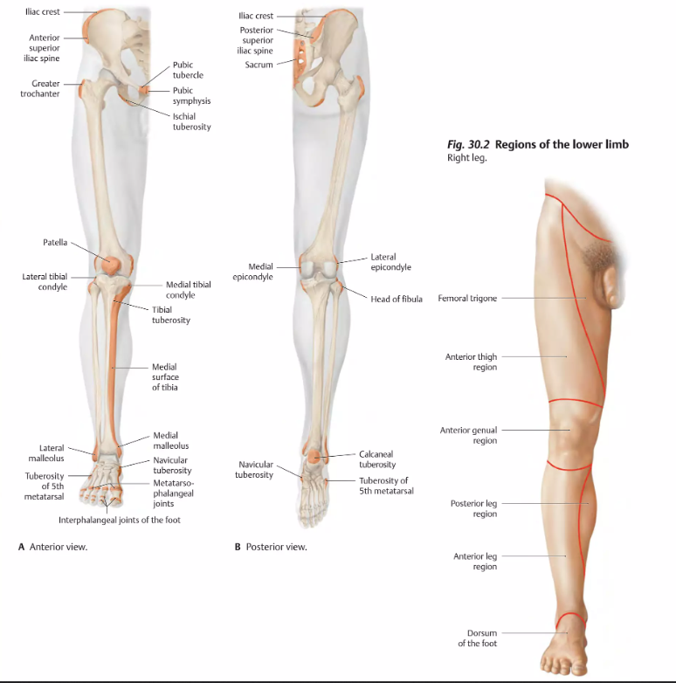
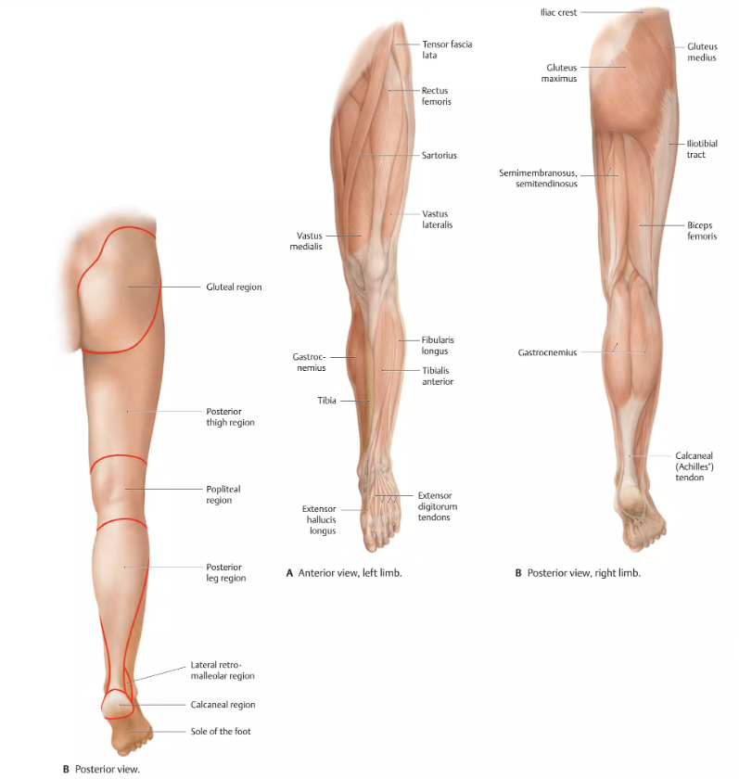
Regions of the Lower Limb

Slide 4
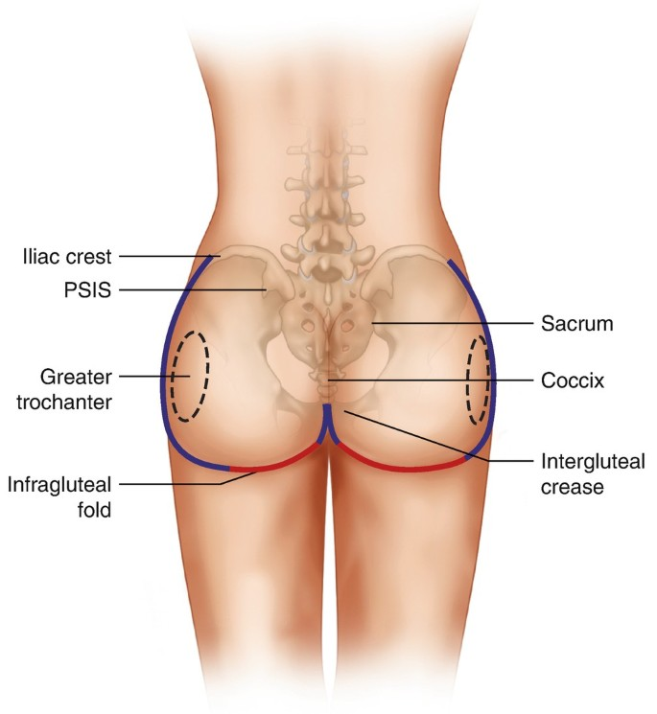
Gluteal Region: Surface Anatomy
The gluteal region, commonly referred to as the buttocks, is an anatomical area located on the posterior aspect of the pelvis.
Boundaries of the Gluteal Region
Superior: Iliac crest (the upper border of the hip bone).
Inferior: Gluteal fold (the crease formed where the buttocks meet the upper thigh).
Medial: Sacrum and coccyx (midline structures of the lower spine).
Lateral: Greater trochanter of the femur (the bony prominence on the side of the hip).

Slide 5
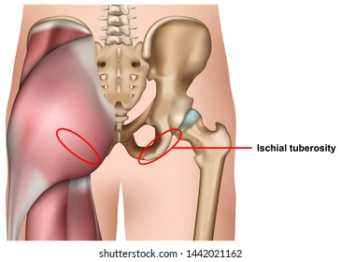
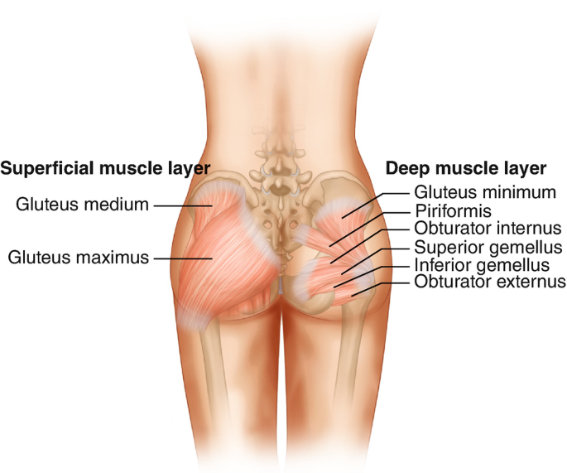
Gluteal Region
The inferior border of the gluteus maximus muscle forms the gluteal fold.
The gluteal (natal) cleft extends vertically to separate the buttocks into two prominences.
In the inferior portion of each buttock, an ischial tuberosity can be palpated; these tuberosities support body weight while seated.
The gluteus maximus muscle forms most of the inferolateral “fleshy” part of the buttock.
The gluteus medius muscle may be palpated only in the superolateral portion of each buttock.

Slide 6
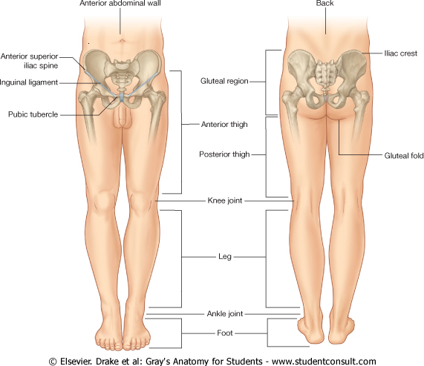
Surface Anatomy
Gluteal region / posterior pelvis
  Iliac crest
  Gluteus maximus
    Cheeks
  Natal/gluteal cleft
    Vertical midline; “Crack”
  Gluteal folds
    Bottom of cheek; “prominence”
  Bony Landmarks: Iliac crest, sacrum, coccyx, greater trochanter of the femur, PSIS, Ischial tuberosity.

Slide 7

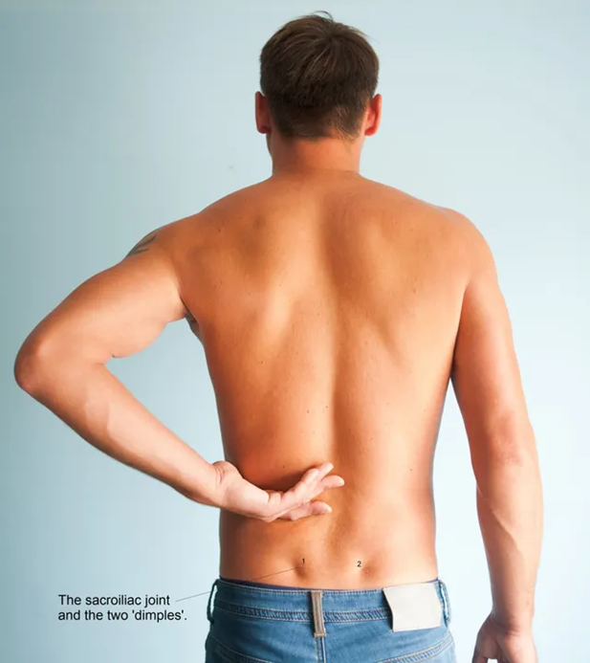
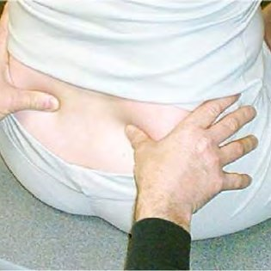
Iliac Crest
Easily traced from the posterior superior iliac spine (PSIS)

Slide 8
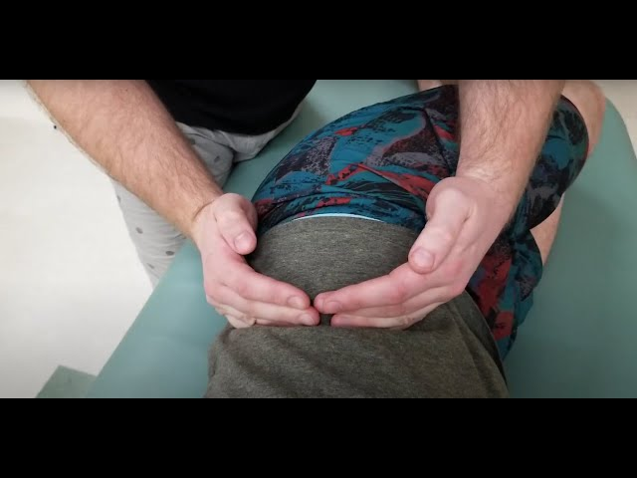

The Iliac Crests
The iliac crest forms the superior border of the ilium and the superior lateral margin of the greater pelvis.
Palpation:
  Ask your model to lie on the side
  Start from the posterior superior iliac spine.
  Trace anteriorly to the anterior superior iliac spine.

Slide 9
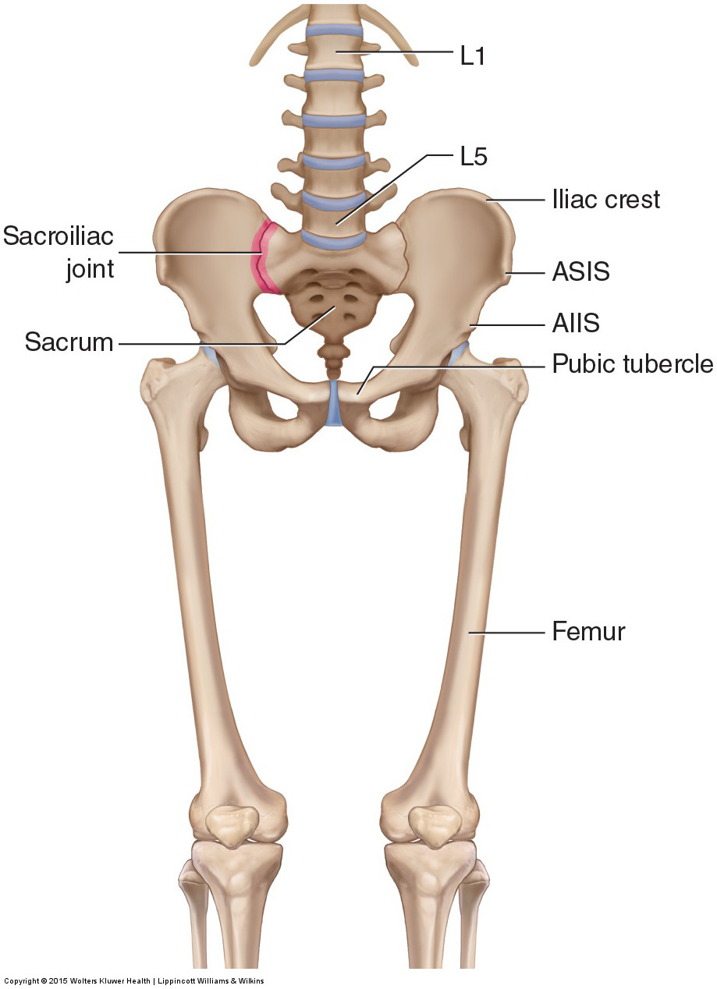
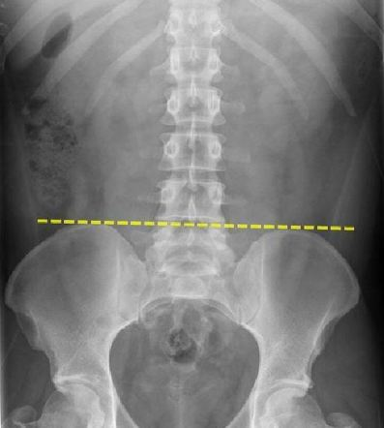
Iliac Crest: Clinical Relevance
Surface Landmark for Anatomical Assessments
Alignment in pelvic examinations.
Reference point for identifying other structures, such as the L4-L5 vertebral level.
Landmark in imaging studies (X-rays, CT scans, and MRIs).

Slide 10
Iliac Crest: Clinical Relevance
Muscle Attachments
The iliac crest serves as the attachment site for several important muscles, including:
  Abdominal muscles (External oblique, Internal oblique, Transversus abdominis)
  Back muscles (Erector spinae, Latissimus dorsi)
  Hip stabilizers (Tensor fasciae latae, Gluteus medius, and Gluteus maximus)

Slide 11

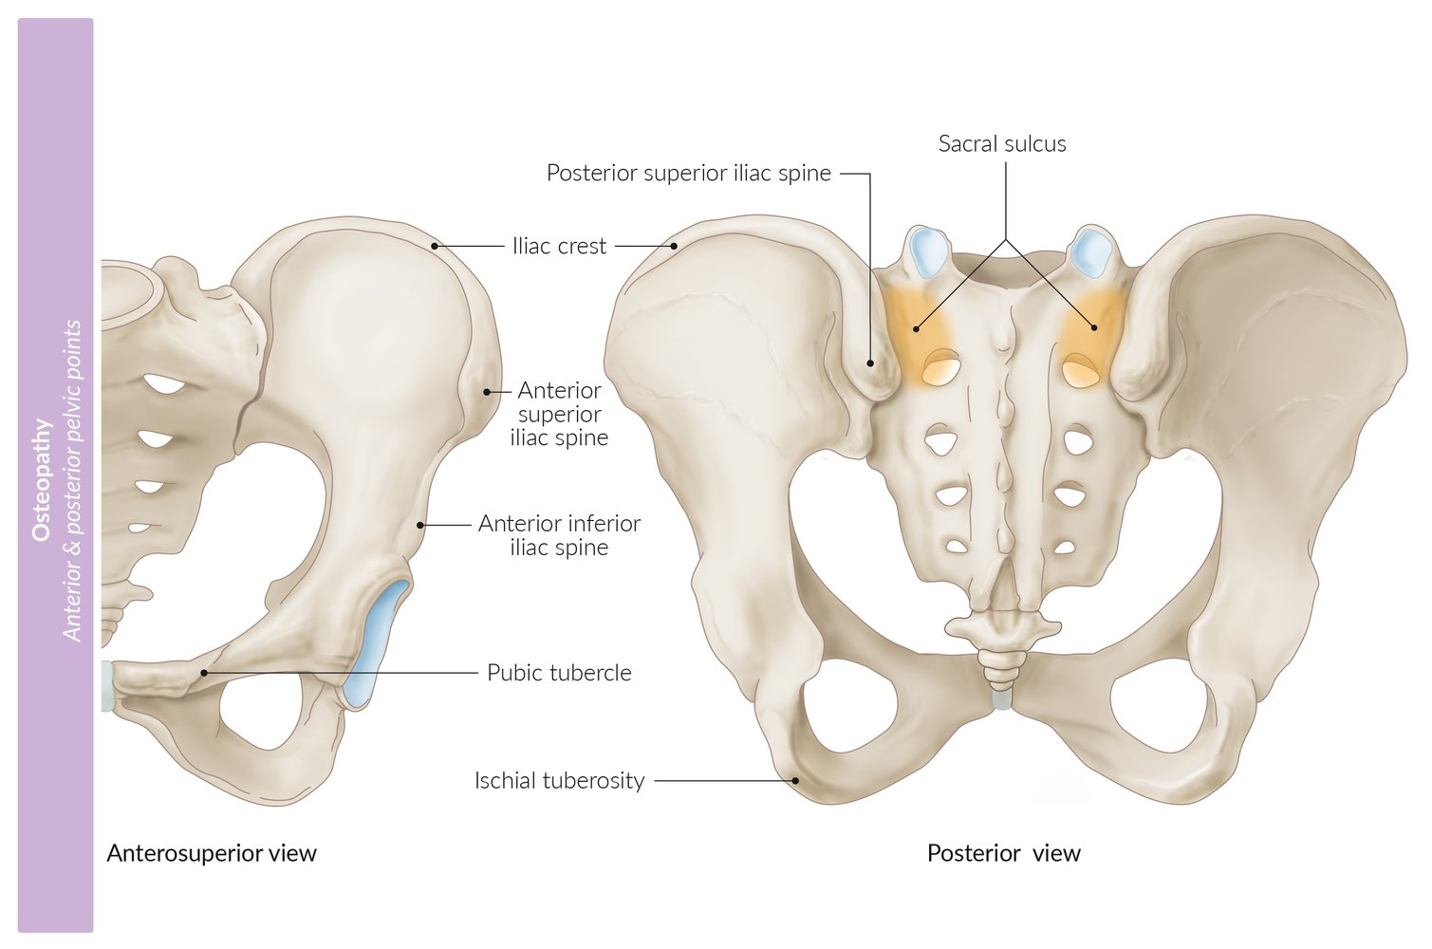
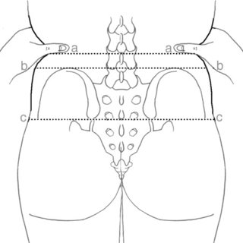
Posterior Superior Iliac Spine (PSIS)
Found on the posterior border of the ilium.
Identified by dimples above the gluteal muscles.
Serves as an attachment for:
  Posterior sacroiliac ligaments
  Multifidus muscle
Consistently crosses the spinous process of S2, making it a reliable lumbar spine landmark.

Slide 12
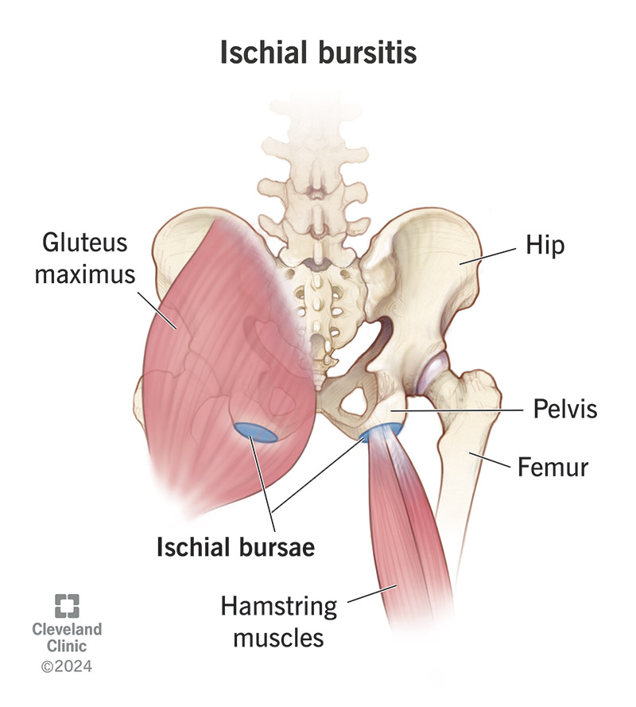
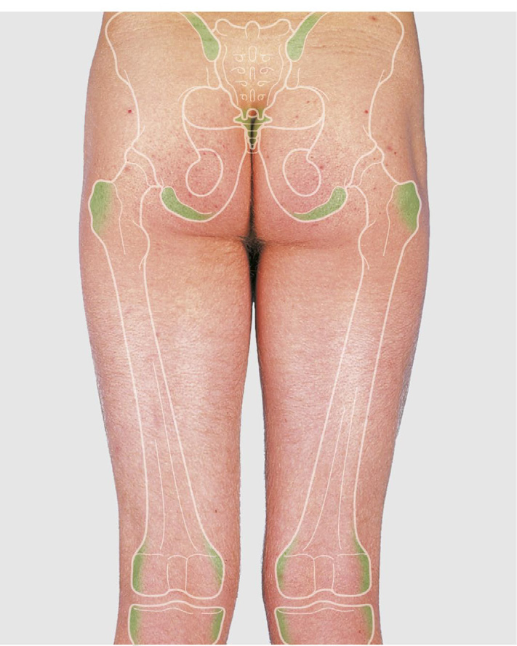
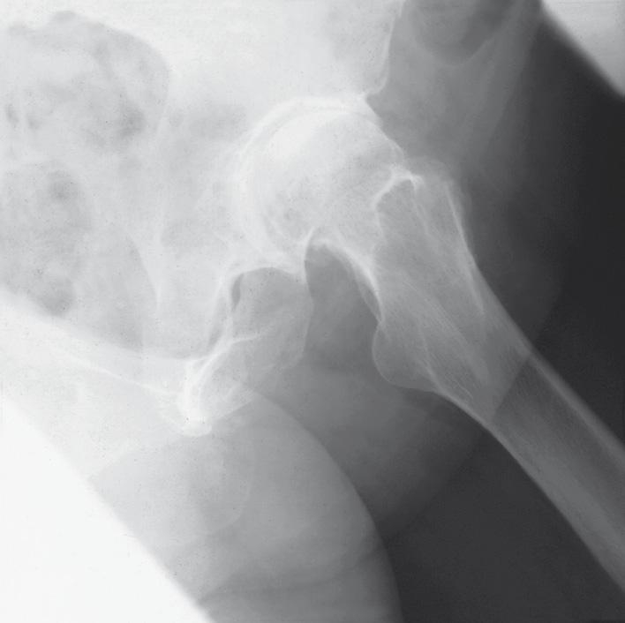
The Ischial Tuberosities
Known as "sitting bones."
Two large bony protrusions on the inferior margin of the ischium.
Best palpated with the patient prone or seated upright with relaxed gluteal muscles.
Mark the lateral boundary of the pelvic outlet.

Slide 13
Palpating the Ischial Tuberosity
Positioning the Patient:
  Prone Position: Have the patient lie face down on an examination table with legs extended. This position allows for easy access to the ischial tuberosities.
Locating the Ischial Tuberosity:
  Start at the Gluteal Fold: Place your hands just above the crease where the buttocks meet the upper thigh (gluteal fold).
  Palpate Upward: Move your fingers upward and slightly inward towards the midline to feel the bony prominence deep beneath the gluteal muscles.
  Apply firm pressure to reach the ischial tuberosity, especially in patients with thicker soft tissue.
Palpation Technique:
  Use the pads of your fingers to apply firm but gentle pressure.
  The ischial tuberosity will feel like a large, round bony prominence.
  Ask the patient to relax their gluteal muscles to make the palpation easier.
  For a seated assessment, place your hand under the patient’s buttock while they are seated upright, and gently press upwards.

Slide 14
Clinical Considerations
Hamstring Tendinopathy: overuse hamstring injury due to hamstrings attachment
Ischial Bursitis: inflammation
Avulsion Fracture: forceful contractions of the hamstrings.
Conditions Assessed with Ischial Tuberosity Palpation
Sciatica: Differential diagnosis with hamstring or ischial bursitis.
Sitting Bone Pain: Assessing for tenderness in patients who report pain when sitting for extended periods.

Slide 15
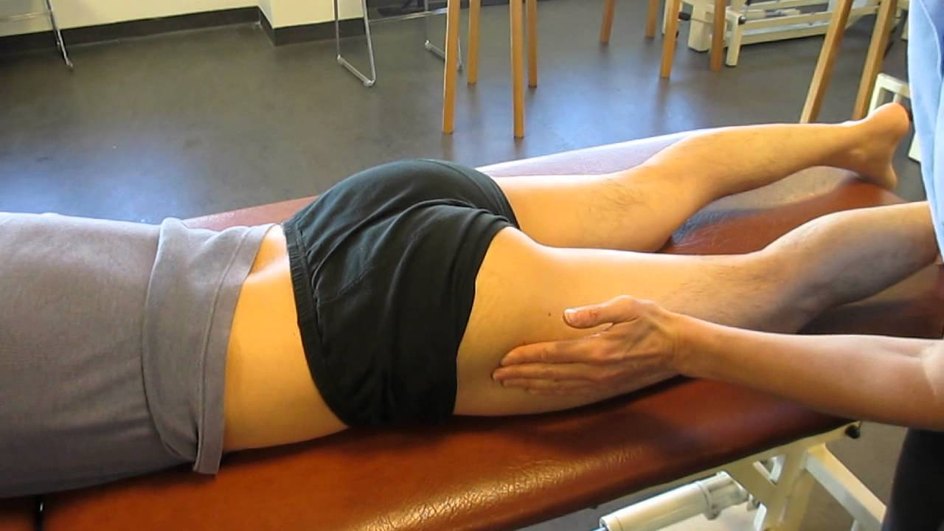
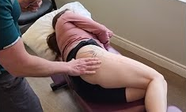
Slide 5: The Greater Trochanter
Large projection on the proximal femur for muscle attachments.
Located lateral to the hip joint, palpable about 10 cm below the iliac crest.
Can be felt during hip rotation.
Important anatomical landmark and attachment site for several gluteal muscles and piriformis,

Slide 16
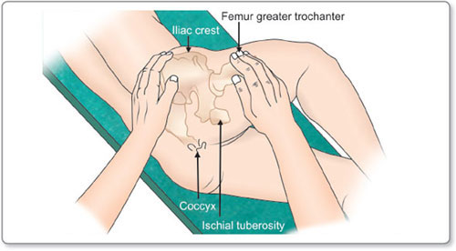
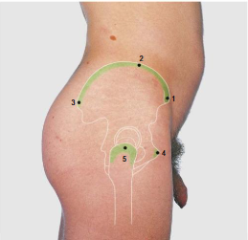
Palpating the Greater Trochanter
Positioning the Patient:
  Side-Lying Position: This position exposes the greater trochanter for easier palpation.
Locating the Greater Trochanter:
  Landmarks: Begin by palpating the iliac crest and moving your hand down the lateral side of the thigh.
  The greater trochanter is located approximately 10 cm below the iliac crest and can be felt as a large bony prominence on the outer aspect of the hip.
Palpation Technique:
  Use the pads of your fingers (index and middle fingers) to apply firm pressure over the lateral aspect of the hip.
  Feel for the rounded contour of the greater trochanter. It should feel like a solid, smooth bump beneath the skin.
  To confirm the location, ask the patient to internally and externally rotate their hip (turning the leg inwards and outwards) while keeping the knee bent. You should feel the greater trochanter move beneath your fingers during rotation.

Slide 17
Conditions Assessed with Greater Trochanter Palpation
Trochanteric Pain Syndrome: Characterized by pain over the lateral hip, often linked to bursitis, tendinopathy, or muscle tears.
Hip Fractures: In elderly patients, tenderness over the greater trochanter may indicate a femoral fracture, especially after a fall.
Hip Osteoarthritis: Palpation of the greater trochanter can help differentiate pain from joint-related issues versus soft tissue or bursal involvement.
Goniometry: Important landmark for the fulcrum in Hip ROM measurements

Slide 18
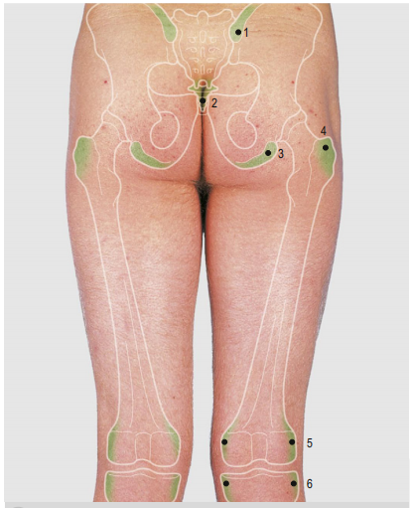
Palpable Gluteal and Posterior thigh Structures
How Many Structures Can You Palpate?
Posterior superior iliac spine
Coccyx
Ischial tuberosity
Greater trochanter
Medial and lateral Femoral condyles
Medial and lateral Tibial condyles

Slide 19
Medial and Lateral Femoral Condyles
Large rounded projections at the end of the femur forming articulating surfaces with the tibia.
The medial condyle is larger than the lateral one.
Joint line of the knee can be felt as a soft depression on either side of the patella.

Slide 20
Medial Femur Condyles: Palpation
Patient Position:
Position the patient in supine (lying on their back) or sitting with the knee flexed at approximately 90 degrees to relax surrounding soft tissues and allow better access to the joint structures.
Locate the Patella:
Begin by identifying the patella (kneecap) as a central reference point on the anterior knee.
Medial Femoral Condyle:
Move your fingers to the medial side of the knee, just proximal to the joint line.
Palpate the medial femoral condyle, a prominent bony structure on the inner aspect of the distal femur.
To confirm, ask the patient to flex and extend their knee gently. You should feel the condyle moving as the femur articulates with the tibia.

Slide 21


Lateral Femur Condyle: Palpation
Lateral Femoral Condyle:
Shift your palpation to the lateral side of the knee, just above the joint line.
Palpate the lateral femoral condyle, which is slightly less prominent than the medial condyle.
Again, flex and extend the knee to feel the movement of the lateral condyle during articulation.
Comparison:
Compare the size, shape, and prominence of the medial and lateral condyles.

Slide 22
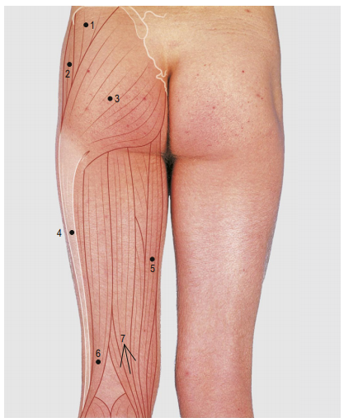
Gluteal region and posterior thigh: Superficial Muscles
Gluteus medius
Tensor fascia lata
Gluteus maximus
Iliotibial tract
Gracilis
Biceps
Semitendinosus overlying semimembranosus

Slide 23
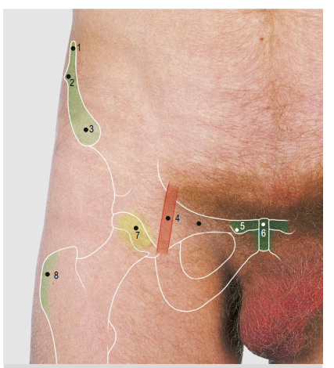
Palpable Structures of the Pelvis and Anterior Thigh
How Many Structures Can You Palpate?
Iliac Crest
Tubercule of Ilium
Anterior Superior Iliac Spine
Femoral artery
Pubic Tubercle
Symphysis Pubis
Head of Femur
Greater Trochanter
Femoral Pulse:
Press deeply, below the inguinal ligament and about midway between symphysis pubis and anterior superior iliac spine.
Use two hands, one on top of the other, to feel the femoral pulse. Note the adequacy of the pulse volume.

Slide 24
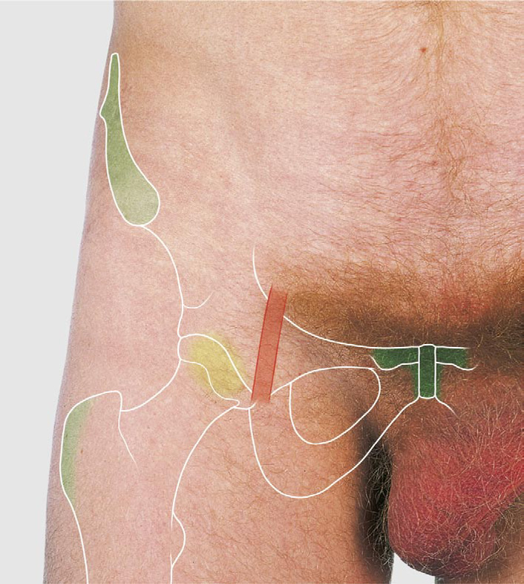

Anterior Superior Iliac Spine (ASIS)
The ASIS is the anterior extremity of the iliac crest.
Approximately 30 cm apart; slightly wider in females.
Provides attachment for:
  Inguinal ligament
  Sartorius muscle
  Tensor fasciae latae

Slide 25
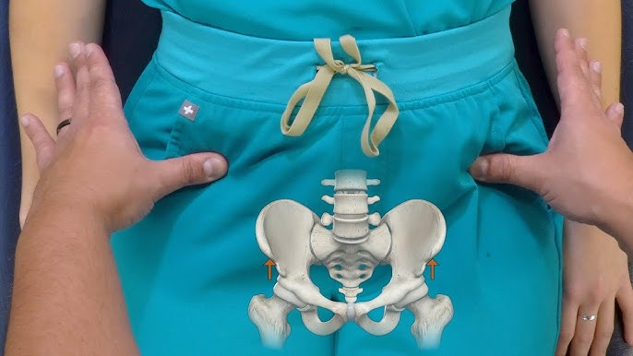
Palpation of the ASIS
Positioning the Patient:
  Model lies supine (on their back) on a flat surface.
  Ensure the model is relaxed to allow easier palpation of the pelvic structures.
Identifying the ASIS:
  From the Iliac Crest, move your fingers forward along the iliac crest toward the front of the pelvis.
  The ASIS is the prominent bony point you will feel at the anterior end of the iliac crest.

Slide 26
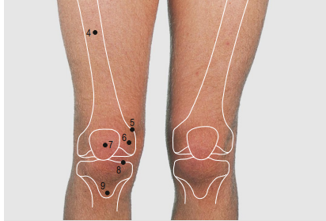
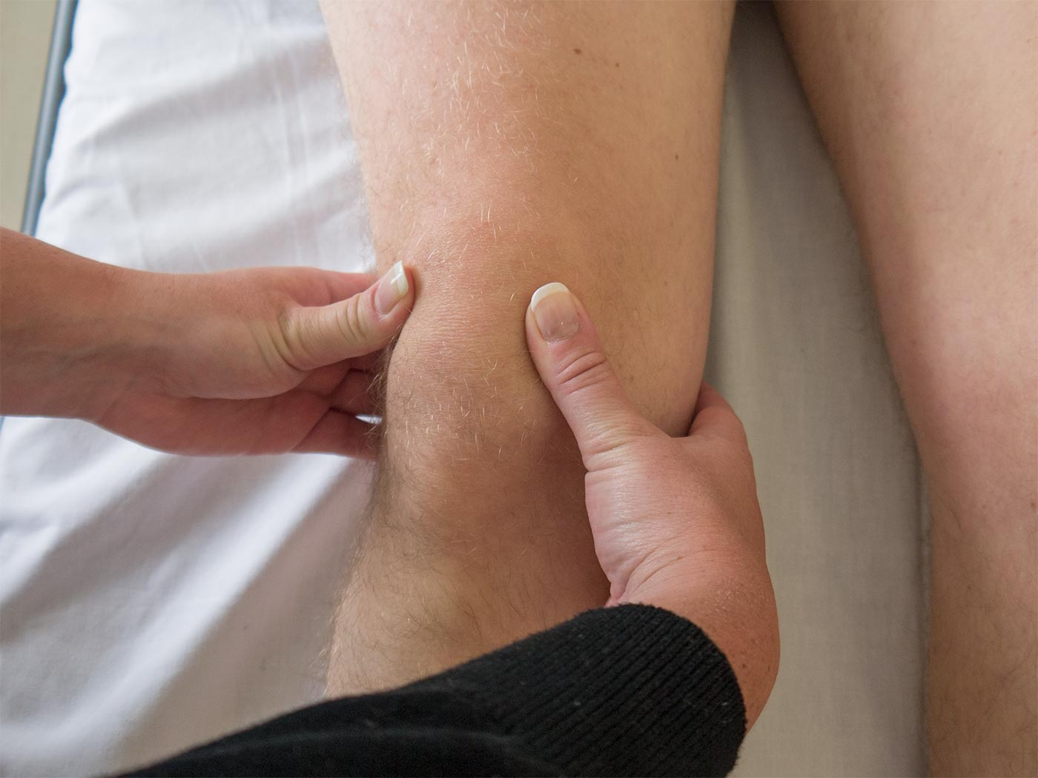
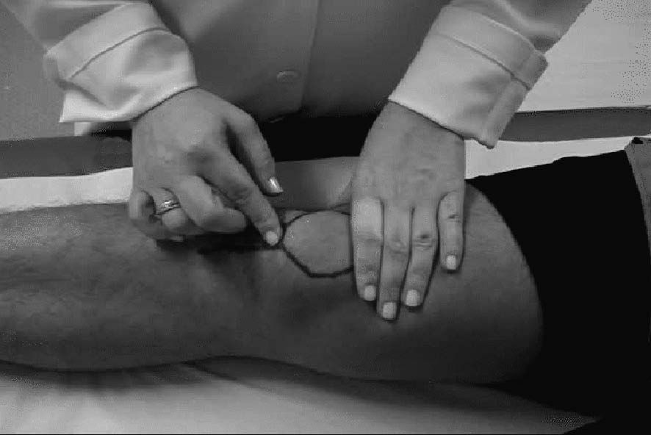
The Patella
Steps for Palpation
Position the model:
  Place the model in a supine position (lying on their back) with the knee fully extended and relaxed. For better palpation of the patella's mobility, the quadriceps must be relaxed.
Locate the Patella:
  Identify the patella at the anterior aspect of the knee. It is a flat, movable bone that can be easily felt beneath the skin.
Assess the Superior and Inferior Borders:
  Run your fingers along the superior border of the patella, where the quadriceps tendon inserts.
  Move to the inferior border, where the patellar ligament connects the patella to the tibial tuberosity.
Palpate the Medial and Lateral Borders:
  Use your fingers to feel the medial border of the patella, noting any tenderness or irregularities.
  Similarly, palpate the lateral border, checking for asymmetry, pain, or bony protrusions.

Slide 27
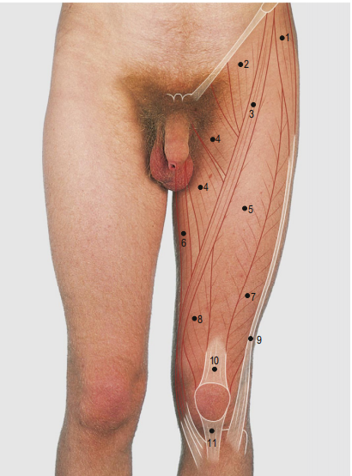
Anterior and medial aspect of thigh: Superficial Muscles
Tensor fascia lata
Iliopsoas
Sartorius
Adductor magnus
Rectus femoris
Gracilis
Vastus lateralis
Vastus medialis
Iliotibial tract

Slide 28
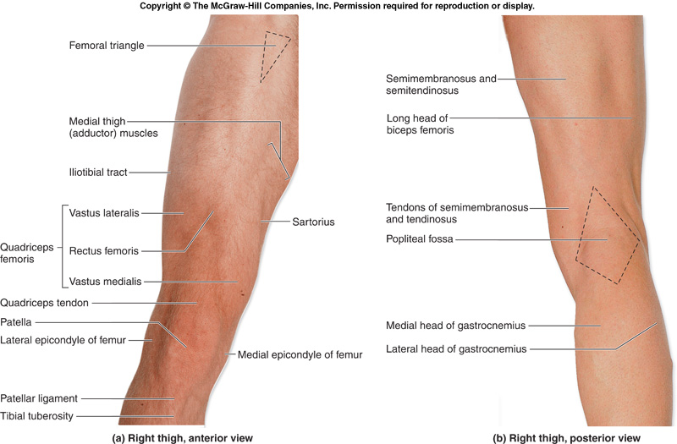

Slide 29
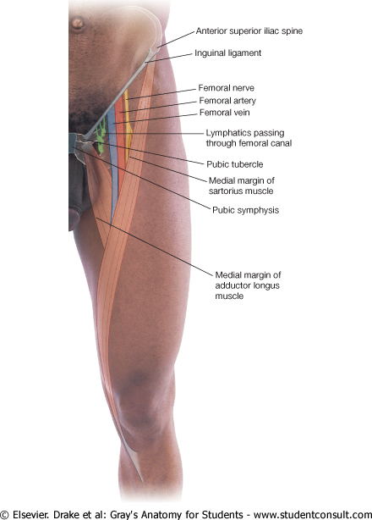
Surface Anatomy: Femoral Triangle
Anterior thigh
Palpate
    Patella
    Condyles of femur
  Femoral Triangle
    Boundaries:
      Sartorius (lateral)
      Adductor longus (medial)
      Inguinal ligament (superior)
    Contents:
      Femoral artery, vein and nerve, lymph nodes

Slide 30
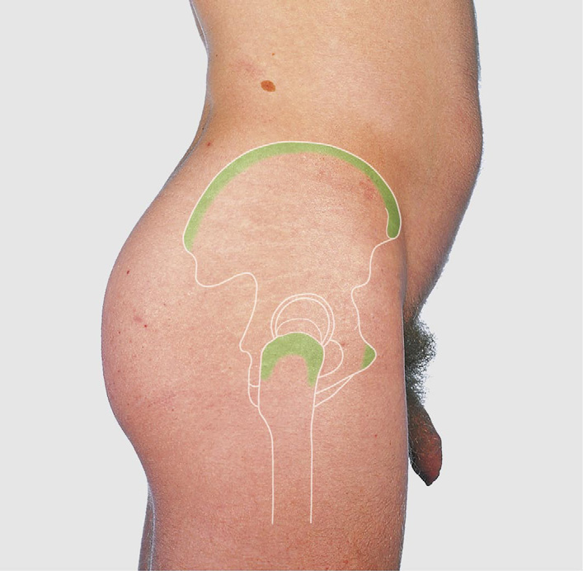
Palpable lateral thigh structures
2
How Many Structures Can You Palpate
Anterior superior iliac spine
Iliac crest
Posterior superior iliac spine
Symphysis pubis
Greater trochanter
3
1
5
4

Slide 31
References
Moore, K.L., Dalley, A.F. & Agur, A.M.R. (2018) Clinically Oriented Anatomy. 8th edn. Philadelphia: Wolters Kluwer.
Drake, R.L., Vogl, A.W. & Mitchell, A.W.M. (2020) Gray’s Anatomy for Students. 4th edn. Philadelphia: Elsevier.
Kilby J, Heneghan NR, Maybury M. Manual palpation of lumbo-pelvic landmarks: a validity study. Manual therapy. 2012 Jun 1;17(3):259-62.Available: https://www.researchgate.net/publication/51672384_Manual_palpation_of_lumbo-pelvic_landmarks_A_validity_study(accessed 7.11.2021)

Slide 32
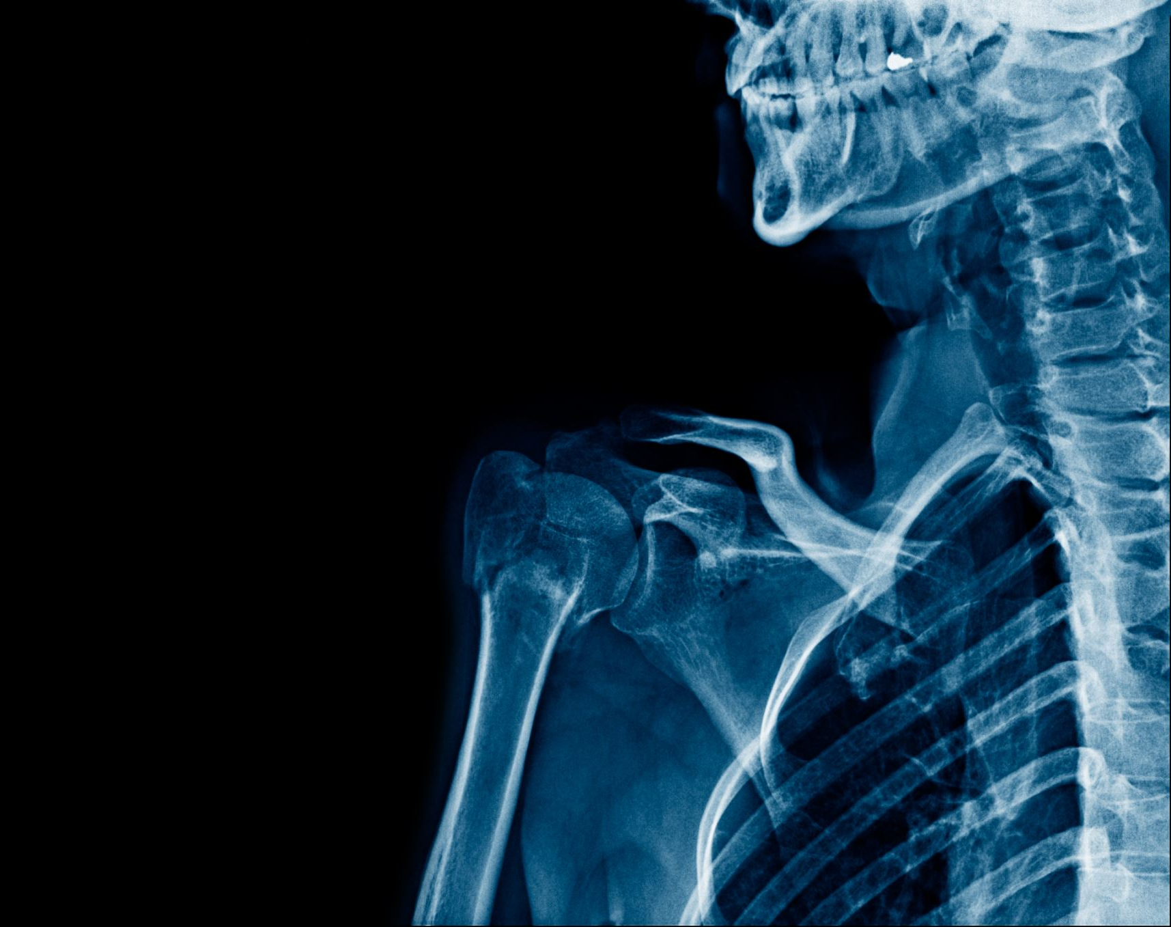
Surface Anatomy of the Leg and foot

Slide 33
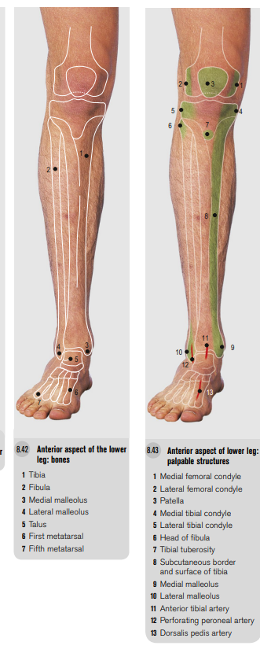
Bony Landmarks of the Lower Leg
Anterior aspect of the lower leg: bones
1 Tibia
2 Fibula
3 Medial malleolus
4 Lateral malleolus
5 Talus
6 First metatarsal
7 Fifth metatarsal
Anterior aspect of lower leg: palpable structures
1 Medial femoral condyle
2 Lateral femoral condyle
3 Patella
4 Medial tibial condyle
5 Lateral tibial condyle
6 Head of fibula
7 Tibial tuberosity
8 Subcutaneous border and surface of tibia
9 Medial malleolus
10 Lateral malleolus
11 Anterior tibial artery
12 Perforating peroneal artery
13 Dorsalis pedis artery

Slide 34
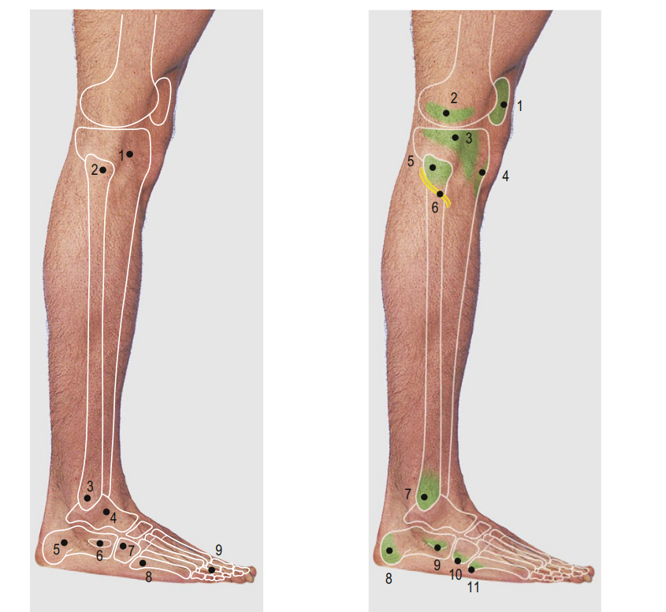
Lateral lower leg
1 Tibia
2 Head of fibula
3 Lateral malleolus
4 Talus
5 Calcaneus
6 Peroneal tubercle of calcaneus
7 Cuboid
8 Fifth metatarsal
9 Phalanges
1 Patella
2 Lateral femoral condyle
3 Lateral tibial condyle
4 Tibial tuberosity
5 Head of fibula
6 Common peroneal nerve
7 Lateral malleolus
8 Calcaneal tuberosity
9 Peroneal tubercle
10 Cuboid
11 Tuberosity of 5th metatarsal

Slide 35
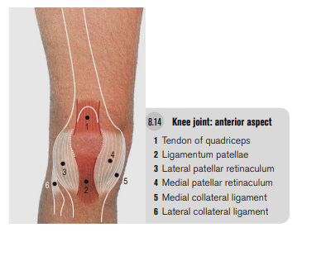
Anterior Knee Joint structures

Slide 36
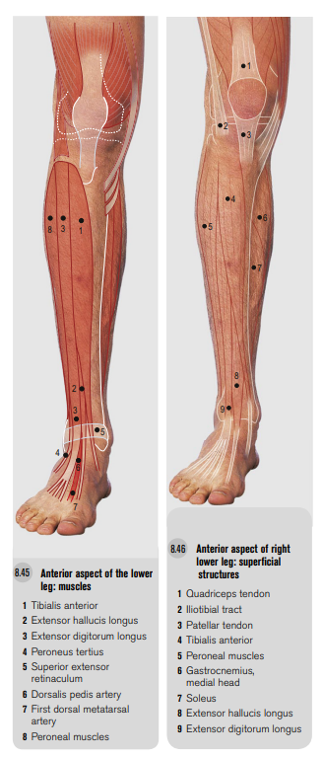
Deep muscle layer
1 Tibialis anterior
2 Extensor hallucis longus 3 Extensor digitorum longus
4 Peroneus tertius
5 Superior extensor retinaculum
6 Dorsalis pedis artery
7 First dorsal metatarsal artery
8 Peroneal muscles
Superficial muscle Layer
1 Quadriceps tendon
2 Iliotibial tract
3 Patellar tendon
4 Tibialis anterior
5 Peroneal muscles
6 Gastrocnemius, medial head 7 Soleus
8 Extensor hallucis longus
9 Extensor digitorum longus

Slide 37
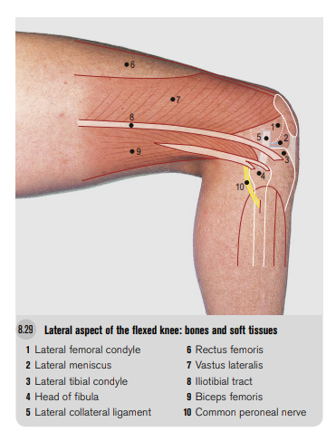
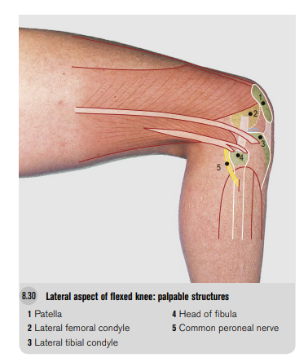
Lateral Knee Joint

Slide 38
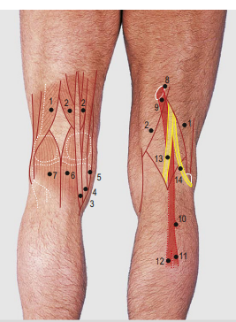
1 Biceps femoris
2 Semimembranosus(on either side of semitendinosus tendon)
3 Semitendinosus
4 Gracilis
5 Sartorius
6 Gastrocnemius, medial head
7 Gastrocnemius, lateral head
8 Adductor hiatus
9 Popliteal artery
10 Anterior tibial artery
11 Peroneal artery
12 Posterior tibial artery
13 Tibial nerve
14 Common peroneal nerve
Posterior Knee

Slide 39
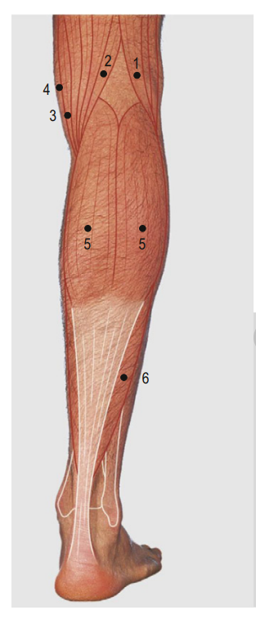
Posterior aspect of the lower leg
1 Biceps
2 Semitendinosus overlying Semimembranosus
3 Sartorius
4 Gracilis
5 Medial and lateral heads of gastrocnemius
6 Soleus

Slide 40
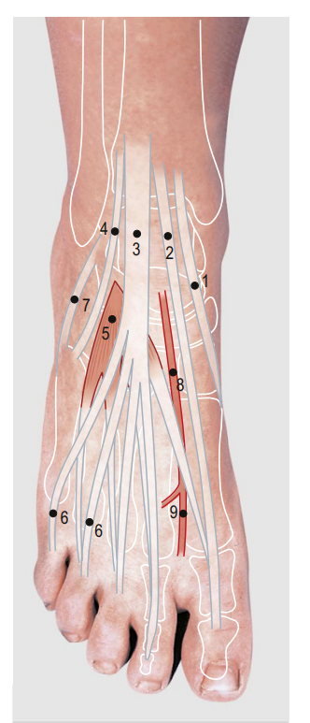
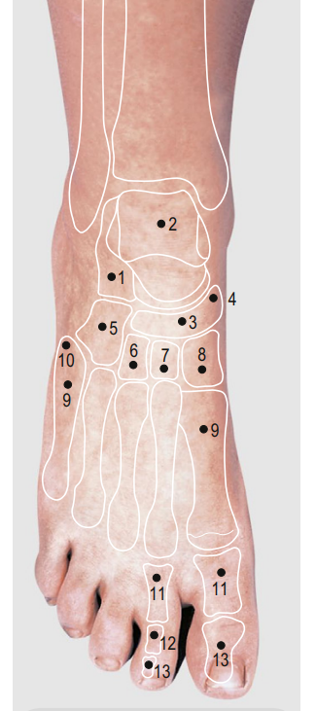
1 Calcaneus
2 Talus
3 Navicular
4 Tubercle of navicular bone
5 Cuboid
6 Lateral cuneiform
7 Intermediate cuneiform
8 Medial cuneiform
9 Metatarsals
10 Tuberosity (styloid process) of fifth metatarsal bone
11 Proximal phalanges
12 Middle phalanx
13 Distal phalanges
1 Tibialis anterior
2 Extensor hallucis longus
3 Extensor digitorum longus
4 Peroneus tertius
5 Extensor digitorum brevis
6 Extensor tendons
7 Peroneus brevis
8 Dorsalis pedis artery
9 First dorsal metatarsal artery

Slide 41
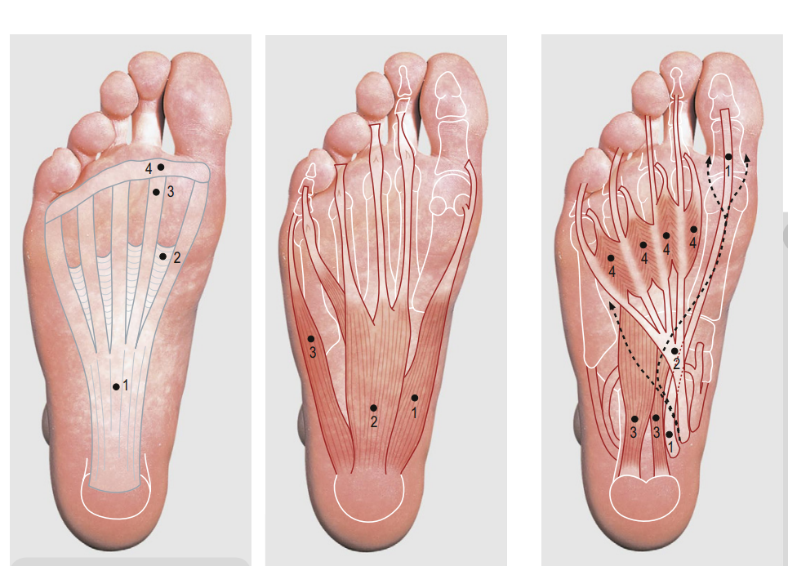
Sole of the foot: plantar fascia
1 Plantar aponeurosis
2 Transverse bands
3 Digital bands
4 Superficial transverse metacarpal ligament
Sole of the Foot: First Muscle Layer
1 Abductor digiti minimi
2 Flexor digitorum brevis
3 Abductor hallucis
Sole of the foot: second muscle layer
1 Flexor hallucis longus
2 Flexor digitorum longus
3 Flexor digitorum accessorius
4 Four lumbrical muscles

Slide 42
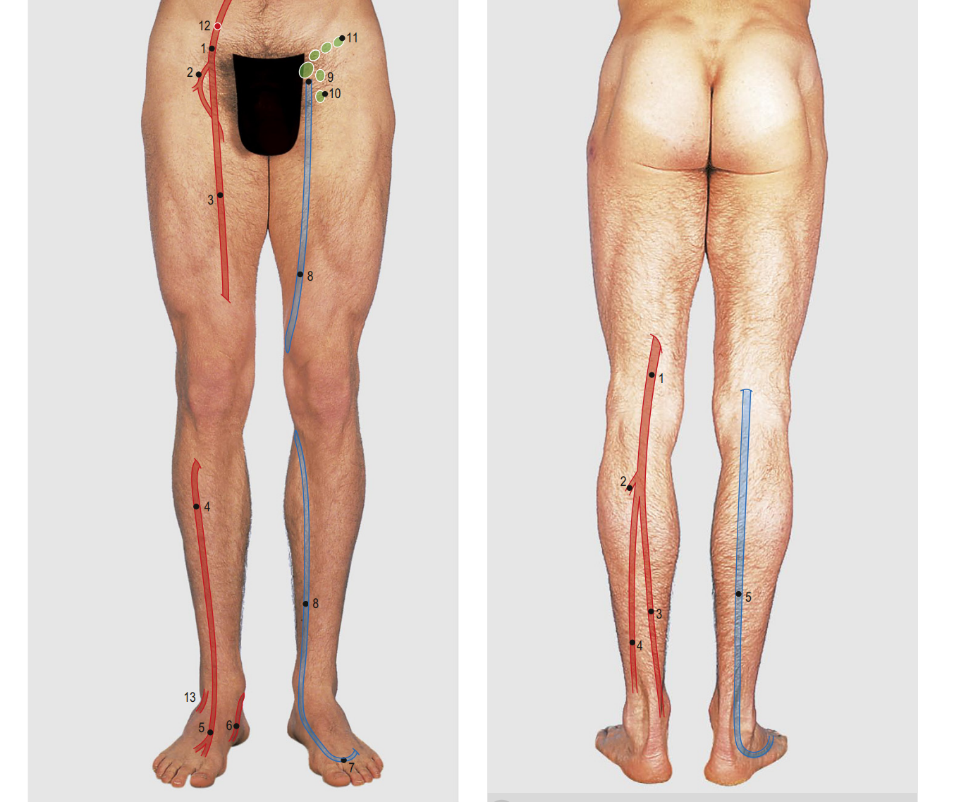
Superficial Vessels of the lower limbs
Anterior:
1 Femoral (common femoral) artery
2 Deep femoral (profunda femoris) artery
3 Femoral (superficial femoral) artery
4 Anterior tibial artery
5 Dorsalis pedis artery
6 Posterior tibial artery
7 Dorsal venous arch
8 Great saphenous vein
9 Saphenous opening
10 Vertical chain of inguinal lymph nodes
11 Horizontal chain of inguinal lymph nodes
12 Point of access to femoral artery
13 Perforating peroneal artery
Posterior:
1 Popliteal artery
2 Anterior tibial artery
3 Posterior tibial artery
4 Peroneal artery
5 Small saphenous vein

Slide 43
References
Moore, K.L., Dalley, A.F. & Agur, A.M.R. (2018) Clinically Oriented Anatomy. 8th edn. Philadelphia: Wolters Kluwer.
Drake, R.L., Vogl, A.W. & Mitchell, A.W.M. (2020) Gray’s Anatomy for Students. 4th edn. Philadelphia: Elsevier.
Kilby J, Heneghan NR, Maybury M. Manual palpation of lumbo-pelvic landmarks: a validity study. Manual therapy. 2012 Jun 1;17(3):259-62.Available: https://www.researchgate.net/publication/51672384_Manual_palpation_of_lumbo-pelvic_landmarks_A_validity_study(accessed 7.11.2021)

